Slide 1
EE746 Neuromorphic Engineering Lecture 3a: Synapse
Udayan Ganguly
udayan@ee.iitb.ac.in
Feb, 14, 2020
This follows Purves Ch 5: Synaptic Transmission
Taylor book Ch 2.3 Basic Synaptic Mechanisms
You can also read http://icwww.epfl.ch/~gerstner/SPNM/node70.html a description on models

Slide 2
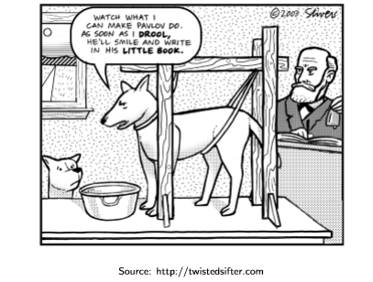
Goal of this Lecture
Why study synapses?
How does synapses work?
What are the synaptic learning rules? Memory
How to model synapses?

Slide 3
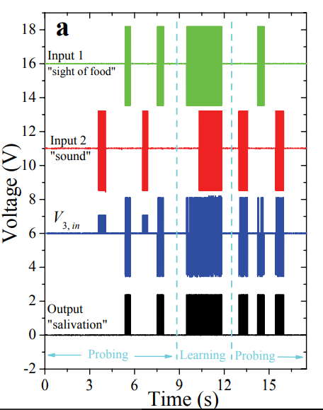
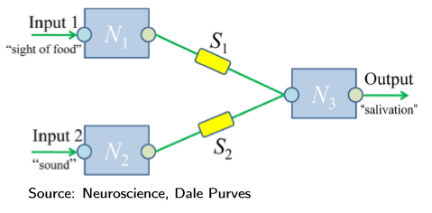
Synaptic Model of Learning / Memory
Source: arxiv.org/pdf/0905.2935
Local and cooperative / associative learning
Notes:
V3 is the input to neuron 3 and is summation of n1 and n2 scaled by synapse s1 and s2, initially s2 was low hence the n3 was not reacting due to sound but after traning s2 was high thus n3 reacted to sound also. In training the food was given corresponding to sound thus s2 increased

Slide 4
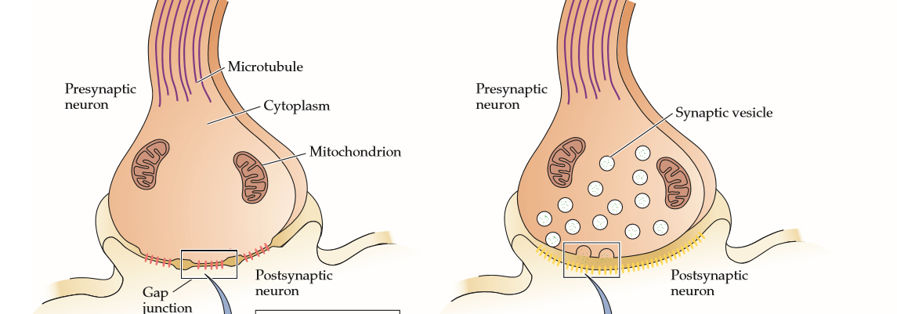
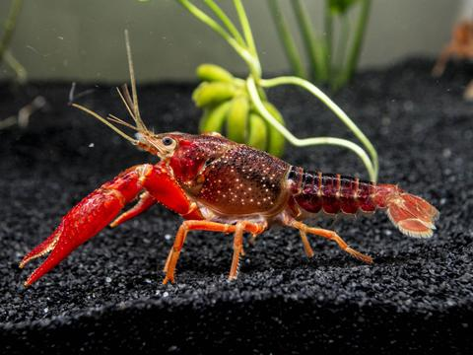
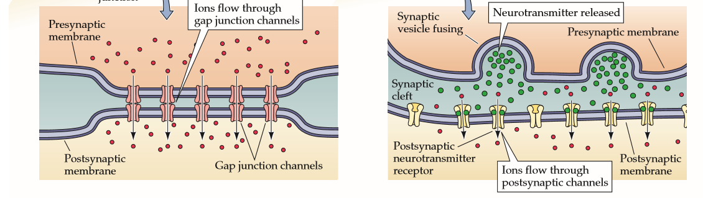
Electrical Synapse
Electrical: minority but found in all nervous systems
Passive current flow through ions;
Not prevalent!

Slide 5
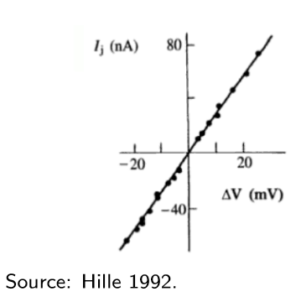
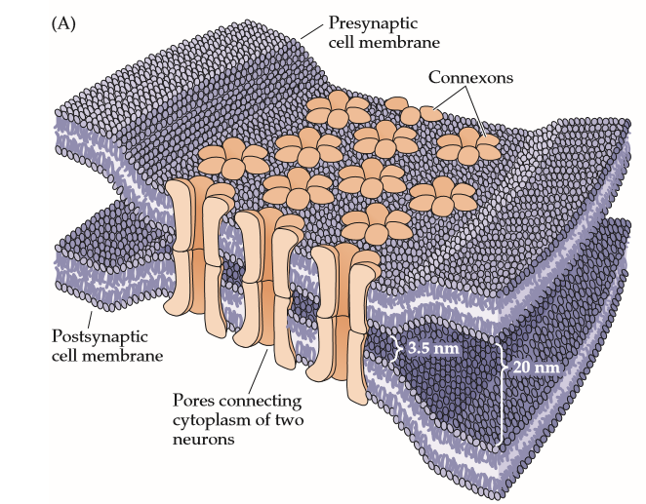
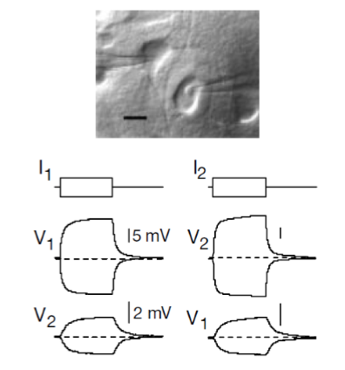
Electrical Synapses
Separation between neurons = 3.5 nm
High conductance pathway between two cells
Gap junction conductivity is symmetric
Sub-threshold currents in pre-synaptic neuron is transmitted to post-synaptic neuro
Source: Nature 402, 75-79 (1999)

Slide 6
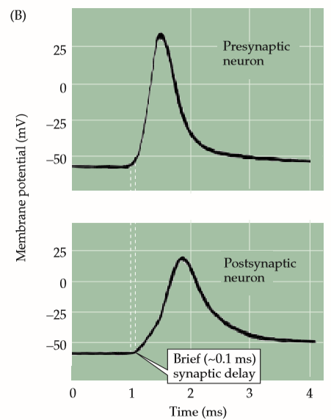
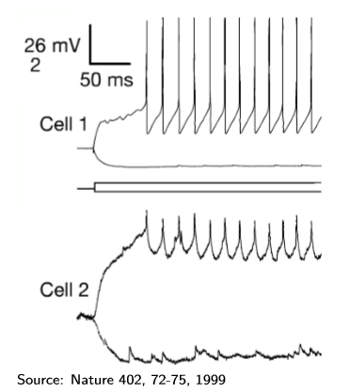
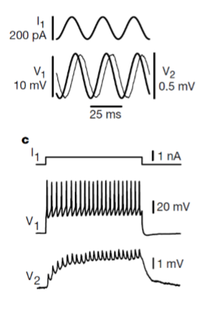
Coupling between neurons
Electrical gap junctions were discovered in crayfish
Pre neuron spike does not necessarily produce post neuron spike
There could be a delay
Delay is normally very small (0.1ms); which helps crayfish respond to threats faster

Slide 7
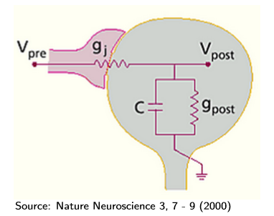
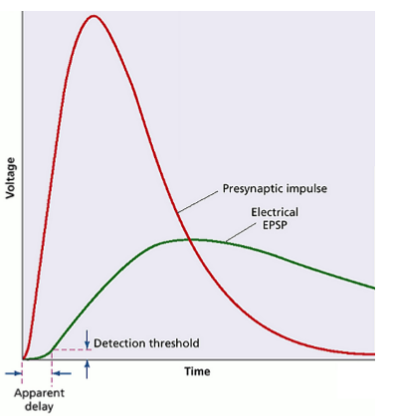
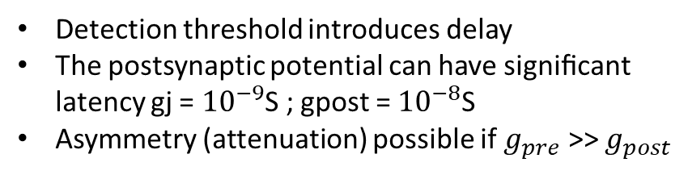
Model of a synapse
Please write down how to engineer independently
Peak EPSP
Delay in EPSP
Detection threshold introduces delay
The postsynaptic potential can have signiﬁcant latency gj = ${10}^{−9}$S ; gpost = ${10}^{−8}$S
Asymmetry (attenuation) possible if $g_{pre}$ >> $g_{post}$
This is almost like post neuron is an extension of pre-neuron i.e. direct electrical connection

Slide 8
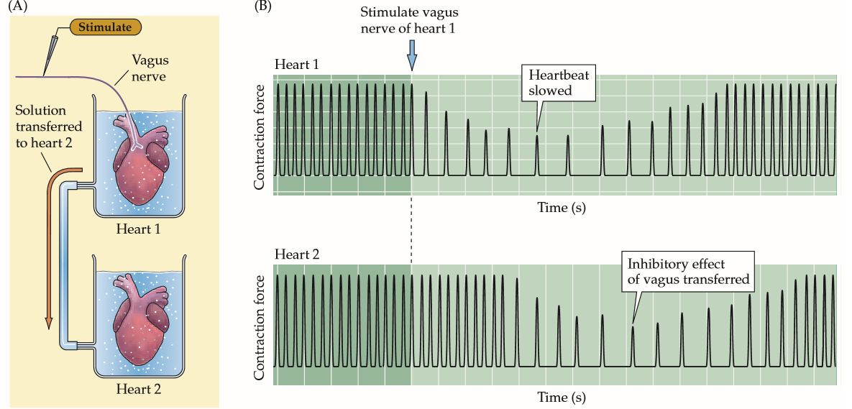
Proof of Existence of chemical signal
German physiologist Otto Loewi 1926.
Is synapse purely electrical? Or are there chemicals that produce signal transfer as well?
It is difficult to study chemical like NT unlike electrical signals (a) they are transient ; (b) to confuse further, electrical signal appears at both end. So is chemical signal connecting electrical signal?
Where the vagus nerve of an isolated frog’s heart was stimulated, the heart rate decreased (upper panel). If the perfusion fluid from the stimulated heart was transferred to a second heart, its rate decreased as well (lower panel). How will you test that it is not electrical?
Notes:
https://en.wikipedia.org/wiki/Otto_Loewi
On Easter Saturday 1921, Otto Loewi dreamt up the solution, got excited, in half-awake state noted the solution in great joy and went back to sleep. but could not read the notes in the morning. It was the longest day he had.
That night he has the same dream. This time he woke up to the lab and immediately did the experiment.
“ “The night before Easter Sunday of [1920] I awoke, turned on the light and jotted down a few notes on a tiny slip of thin paper. Then I fell asleep again. It occurred to me at 6.00 o’clock in the morning that during the night I had written down something important, but I was unable to decipher the scrawl. The next night, at 3.00 o’clock, the idea returned. It was the design of an experiment to determine whether or not the hypothesis of chemical transmission that I had uttered 17 years ago was correct. I got up immediately, went to the laboratory, and performed a simple experiment on a frog heart according to the nocturnal design.””
https://www.ncbi.nlm.nih.gov/pmc/articles/PMC4291908/

Slide 9
Two Synapse Types: Electrical & Chemical
Electrical: minority but found in all nervous systems
Chemical: Common
Passive current flow through ions;
Not prevalent!
Ion flow is modulated by neuro transmitters which open/close ion channels:

Slide 10
Electrical vs. Chemical Synapses
 | Electrical | Chemical
Occurrence | Ubiquitous but fewer in number | Majority but specialized with 100 NTs
Signal Direction | Bi-directional / symmetric | Unidirectional: Pre to post neuron
Speed | Fast due to direct contact | Has delays and more complex dynamics with different stages
Control |  | Excitatory vs. inhibitory
Adaptation |  | Plasticity

Slide 11
Chemical Synapse
Information transmission can happen in only one direction unidirectional transmission.
Chemicals called neurotransmitters stored in synaptic vesicles “carry” the information.
Physical separation of neurons is about 20-40nm.
Transmission of information takes about 1-5ms.
Response can be diﬀerent from the input - excitatory or inhibitory.
Synaptic strength can change plasticity

Slide 12
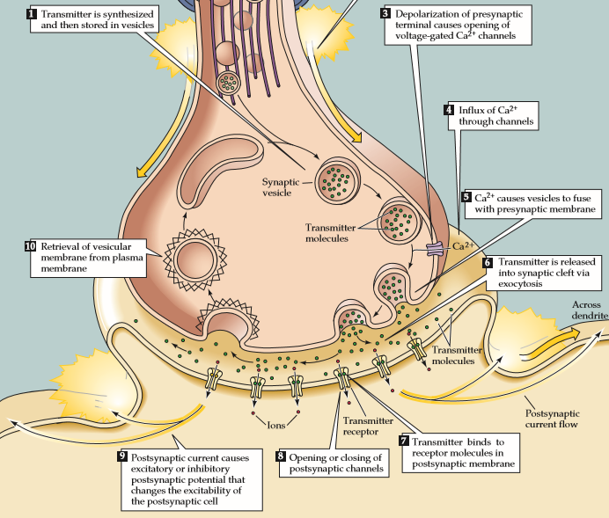
Details
Vesicles store NTs AcetylCholine, Dopamine, Norepinephrine, γ-aminobutyric acid (GABA), Glutamate
AP opens voltage gated Ca2+ channels.
Ca2+ causes vesicles to fuse with presynaptic membrane, and release of NTs.
NTs diﬀuse and bind to the receptors in post-synaptic membrane, leading to opening or closing of channels in the post-synaptic neuron.
Vesicular membrane is retrieved by the pre-synaptic membrane and reused.
Which is the slowest step?

Slide 13
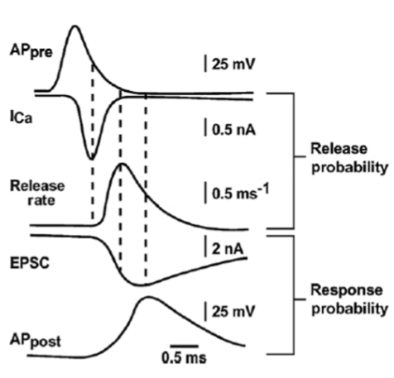
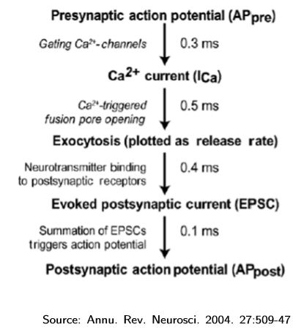
Timing Delay
How may steps is there between Exocytosis and EPSC?
Which is the slowest step?
Possibly diffusion of NT

Slide 14
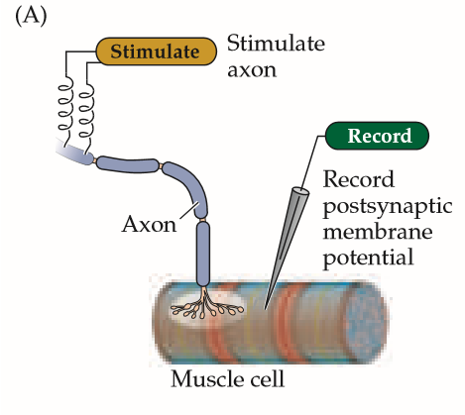
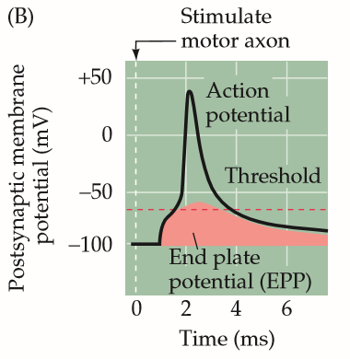
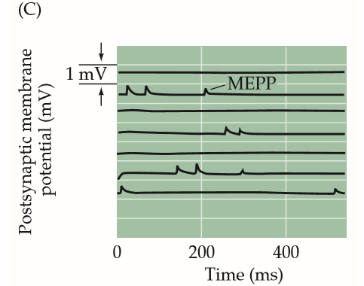
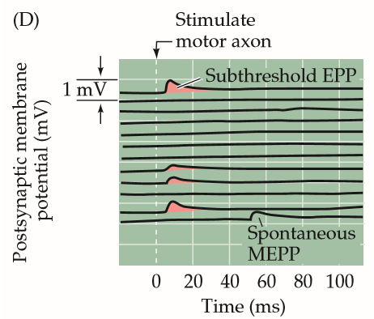
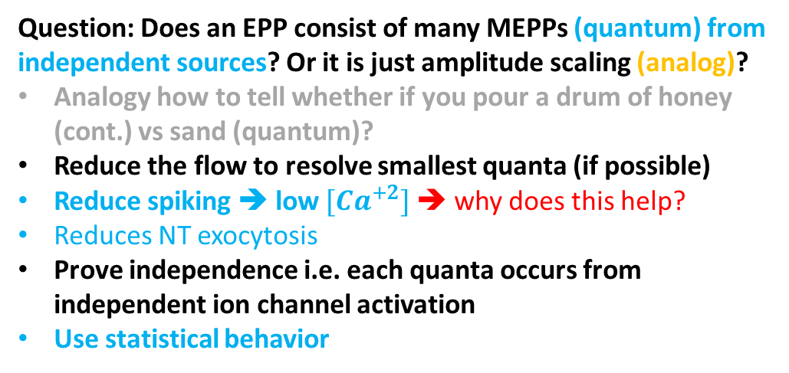
Quantal Nature of Synaptic Transmission
Fatt and Katz, 1952
Question: Does an EPP consist of many MEPPs (quantum) from independent sources? Or it is just amplitude scaling (analog)?
Analogy how to tell whether if you pour a drum of honey (cont.) vs sand (quantum)?
Reduce the flow to resolve smallest quanta (if possible)
Reduce spiking ➔ low $[Ca^{+2}]$➔ why does this help?
Reduces NT exocytosis
Prove independence i.e. each quanta occurs from independent ion channel activation
Use statistical behavior
Stimulated response is muted with low Ca+2 concentration
Spontaneous miniature EPPs (MEPPs) without presynaptic stimulation
Does not respond
Responds
Normal response
Notes:
From Purves:
The relationship between the full-blown end plate potential and MEPPs was clarified by careful analysis of the EPPs. The magnitude of the EPP provides a convenient electrical assay of neurotransmitter secretion from a motor neuron terminal; however, measuring it is complicated by the need to prevent muscle contraction from dislodging the microelectrode. The usual means of eliminating muscle contractions is either to lower Ca2+ concentration in the extracellular medium or to partially block the postsynaptic ACh receptors with the drug curare. As expected from the scheme illustrated in Figure 5.3, lowering the Ca2+ concentration reduces neurotransmitter secretion, thus reducing the magnitude of the EPP below the threshold for postsynaptic action potential production and allowing it to be measured more precisely. Under such conditions, stimulation of the motor neuron produces very small EPPs that fluctuate in amplitude from trial to trial (Figure 5.6D). These fluctuations give considerable insight into the mechanisms responsible for neurotransmitter release.

Slide 15
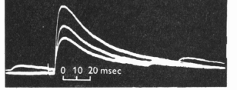
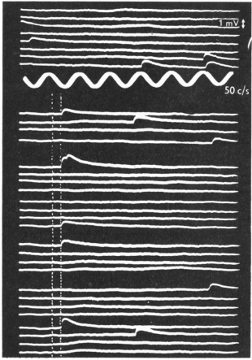
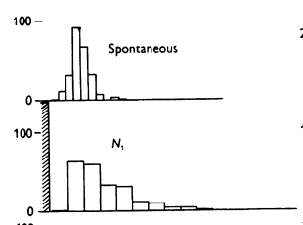
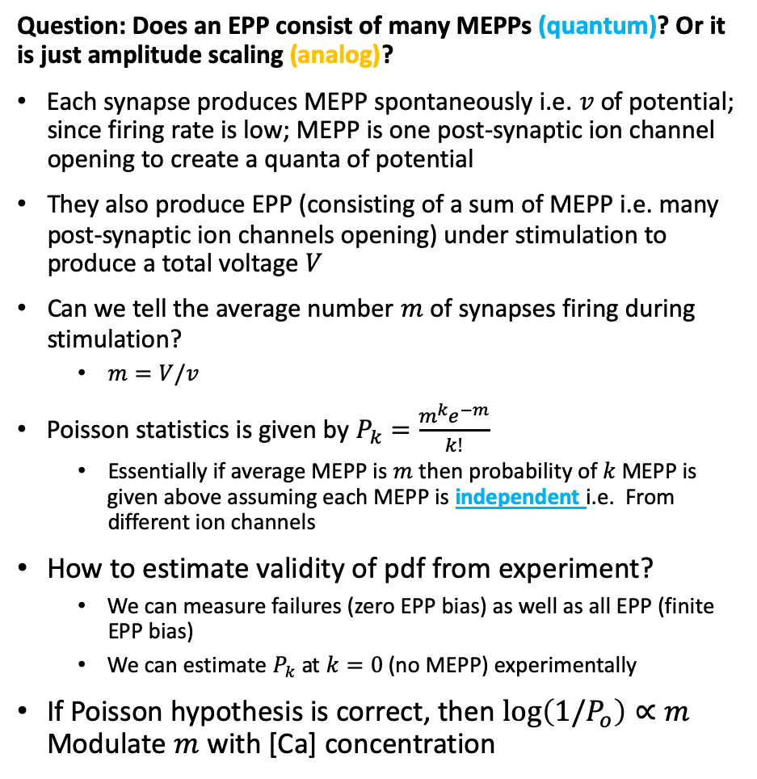
Statistical Synapse Model
Fatt and Katz, 1952
Question: Does an EPP consist of many MEPPs (quantum)? Or it is just amplitude scaling (analog)?
Each synapse produces MEPP spontaneously i.e. $v$ of potential; since firing rate is low; MEPP is one post-synaptic ion channel opening to create a quanta of potential
They also produce EPP (consisting of a sum of MEPP i.e. many post-synaptic ion channels opening) under stimulation to produce a total voltage $V$
Can we tell the average number $m$ of synapses firing during stimulation?
$m=V/v$
Poisson statistics is given by $P_{k}=\frac{m^{k}e^{−m}}{k!}$
Essentially if average MEPP is $m$ then probability of $k$ MEPP is given above assuming each MEPP is independent i.e. From different ion channels
How to estimate validity of pdf from experiment?
We can measure failures (zero EPP bias) as well as all EPP (finite EPP bias)
We can estimate$P_{k}$ at $k=0$ (no MEPP) experimentally
If Poisson hypothesis is correct, then $log\left(1/P_{o}\right)∝m$ Modulate $m$with [Ca] concentration
MEPP?
10mV
spontaneous
stimulus
stimulated
Notes:
https://www.ncbi.nlm.nih.gov/pmc/articles/PMC1392564/pdf/jphysiol01439-0123.pdf

Slide 16
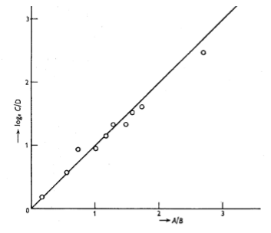
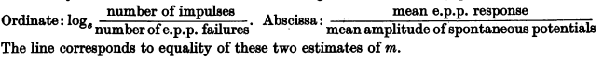

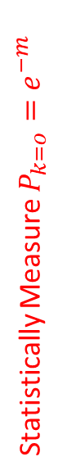
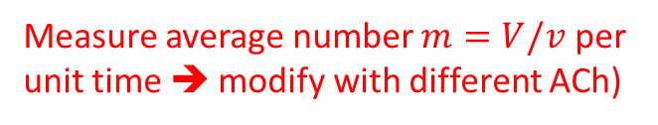
Proving statistical model by estimating m
independently estimate
from statistics
vs.
From potential
A match implies the statistical model is correct i.e. spikes are independent
Statistically Measure $P_{k=o}=e^{−m}$
$$log⁡(1/P_{k=o})$$
-m
Measure average number $m=V/v$ per unit time ➔ modify with different ACh)

Slide 17
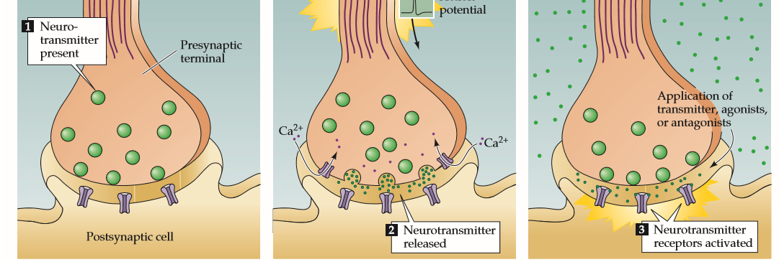
Quantal Nature of Synaptic Transmission
Fatt and Katz, 1952
Amplitude of response measured at the neuromuscular junction when nerve cell is stimulated to induce spikes.
Neurotransmitters are released in ﬁxed increments, or quanta.
Each quanta produces a postsynaptic potential of ﬁxed amplitude.
Total response = amplitude of quantal response × number of quanta of transmitter.
The probability of release is low (0.1−0.3). Why?
Does not respond
Does not respond
Responds
Responds

Slide 18
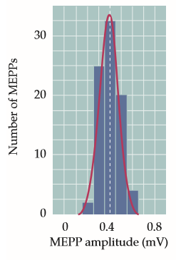
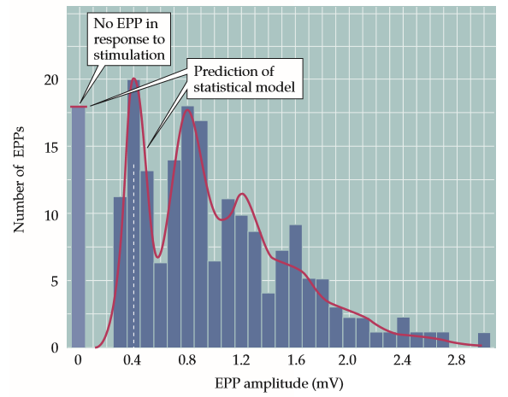
Quantal Nature of Synaptic Transmission
Cell, Vol. 100, Neuron Vol. 25, S-S55, Feb, 2000
Amplitudes of the spontaneous miniature potentials ﬁts a Gaussian curve.
The distribution of responses falls into a number of peaks.
The ﬁrst peak, at 0 mV represents release failures.
The peak at 0.4 mV represents the unit potential.
Peaks occur at integral multiples of amplitude of the unit potential.
Spread in peak due to randomness in amount of transmitter in each quantum.

Slide 19
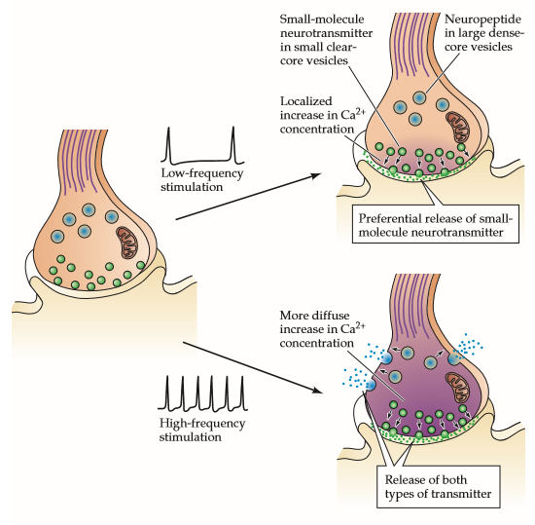
Rate Dependent Mechanisms
Write down the sequence for Low Frequency pre-AP?
Pre-AP
Low Ca release
Exocytosis of {small molecule NT}
Ion channel opening by NT
Post-AP
Write down the sequence for High Frequency pre-AP?
Pre-AP
High Ca release
Exocytosis of {small molecule NT} + {neuropeptide}
Ion channel opening by NT
Post-AP

Slide 20
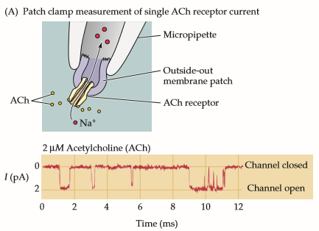
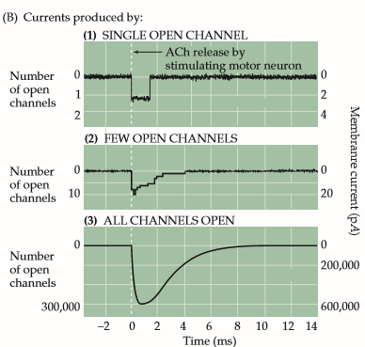
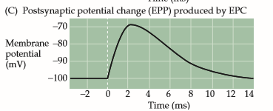
Generating a synaptic current using NT
Erwin Neher and Bert Sakmann 1976
A single Acetyle Choline (ACh) receptor channel produces noisy current.
But together, it produces a smooth End Plate Current (EPC) i.e. synaptic current and resultant End plate potential (EPP)
If EPP reaches a threshold Post AP is initiated with voltage gated Na and K channels responding ➔ chemical (NT) to electrical (post AP) signal transfer

Slide 21
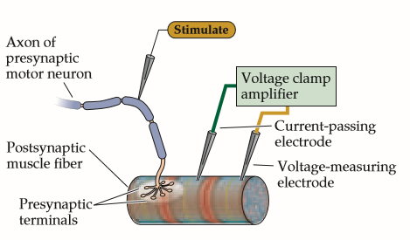
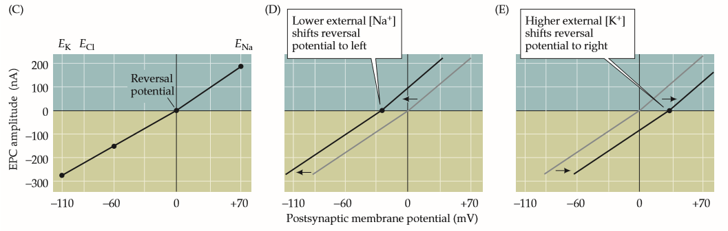
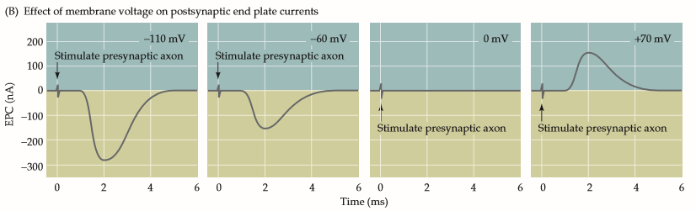
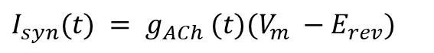
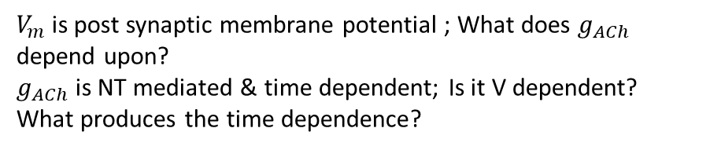
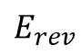
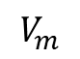
Synapse Response
The membrane potential at which no current flows during neuro transmitter action.
$$V_{m}$$
$I_{syn}(t) = g_{ACh} (t)(V_{m} −E_{rev})$
$$E_{rev}$$
$V_{m}$ is post synaptic membrane potential ; What does $g_{ACh}$ depend upon?
$g_{ACh}$ is NT mediated & time dependent; Is it V dependent?
What produces the time dependence?

Slide 22
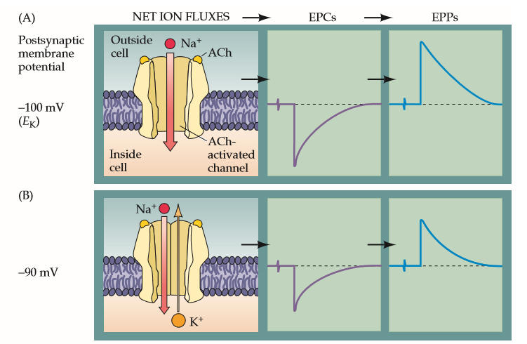
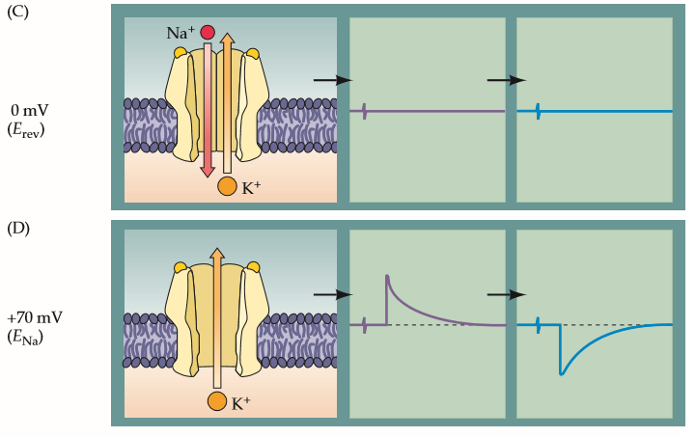
ACh Receptor
Is ACh gated channel permeable to which ion?
Hint: What are the relevant ions?
What was the resting potential of V controlled [K] channel?
Which ion produces current at
a) resting potential?
b) +70mV?
c) 0mV

Slide 23

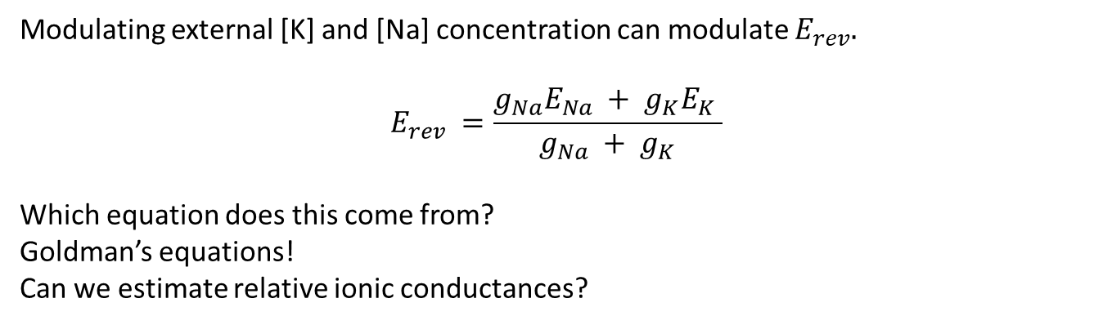
Modulation of $E_{rev}$
Modulating external [K] and [Na] concentration can modulate $E_{rev}.$
$$E_{rev} =\frac{g_{Na}E_{Na} + g_{K}E_{K} }{g_{Na} + g_{K}}$$
Which equation does this come from?
Goldman’s equations!
Can we estimate relative ionic conductances?
Ionic flow is dependent upon ionic gradient;
Conductance dependents upon Ach, time;
Is Ion Flow potential dependent?

Slide 24
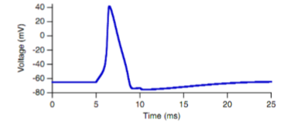




$E_{rev}$ for excitatory vs. inhibitory
Excitatory synapses have $E_{rev}=0mV$
This implies that any [Na] current will flow is high at resting potential (say -60mV) but decreases as potential rises
Inhibitory synapses have $E_{rev}=−70mV$;
This implies that any [Na] current will flow zero at resting potential (say -60mV); then as potential rises due to EPP increase, the [K] current increases to inhibit the potential increase towards threshold.
Does $E_{rev}$ produce a limit on the threshold of spiking i.e. metastable membrane potential?
What is metastable potential (i.e. threshold) for spiking?
Same medium (concentration gradient) will produce different ionic flow due to different type of synapse!

Slide 25

Time dependent model for EPC
Write down a mathematical expression to capture the time dependence of the EPSC starting at $t_{0}$
Notes:
`h is the one sided distribution.

Slide 26

Excitatory PSP
Receptor on the post-synaptic cell, and not the transmitter determines whether E or I
Example - a neuronal synapse that uses glutamate as the transmitter.
Which ion channel must it activate?
Causes Na+/K+ to ﬂow into the cell.
Resulting EPSP depolarizes the postsynaptic membrane potential, (brings it to 0 mV).
EPSP increases probability of an AP in the postsynaptic neuron

Slide 27


Inhibitory PSP
Example : a neuronal synapse that uses GABA as its transmitter.
Which ion channel must it activate?
Opens channels permeable to Cl−.
Negatively charged Cl− ﬂows into the cell. ($E_{Cl}$ = −70 mV)
Binding of GABA reduces postsynaptic membrane potential below the threshold,
IPSP reduces the probability of an AP in the postsynaptic neuron
Notes:
(gamma-aminobutyric acid)

Slide 28

Summation
E1+I?
E1+E2?
E1+E2+I?
Typical EPSPs is 0.2−0.4 mV
Assuming linear summing, it would take 10−50 typical EPSPs to exceed threshold.
A single neuron can integrate inputs from multiple synapses (5000−10,000), with varying strength and nature (Excitatory+Inhibitory)
Why is each E/I PSP added?
What is the fraction of pre-neurons firing?

Slide 29


Post-synaptic integration
Time Correlation is detected by synaptic current for
Self
w.r.t. other synapses
Spatial correlation is detected i.e. different pre-neurons in space connected to the post-neuron
Rate
Coincidence

Slide 30

Summary
Synapse has two types
Electrical – common but simple bi-directional connection
Chemical – more interesting,
uni-directional
Converts voltage AP to post synaptic current to produce EPP
It is stochastic
Modulated by NT that modulated conductance with time $g_{L}(t)$
Model is a simple curve fit.
Excitatory ($E_{rev}=0mV)$ increases potential
Inhibitory ($E_{rev}=−70mV$) decreases potential
Same medium (concentration gradient) will produce different ionic flow due to different type of chemical synapse!

